Slide 1

بسم اللہالرحمٰن الرحیم
My Lord, put my heart at peace for me,​ and make my task easy for me and remove the knot from my tongue, so that they may understand my speech.​
​​[20:24-28]​

Slide 2
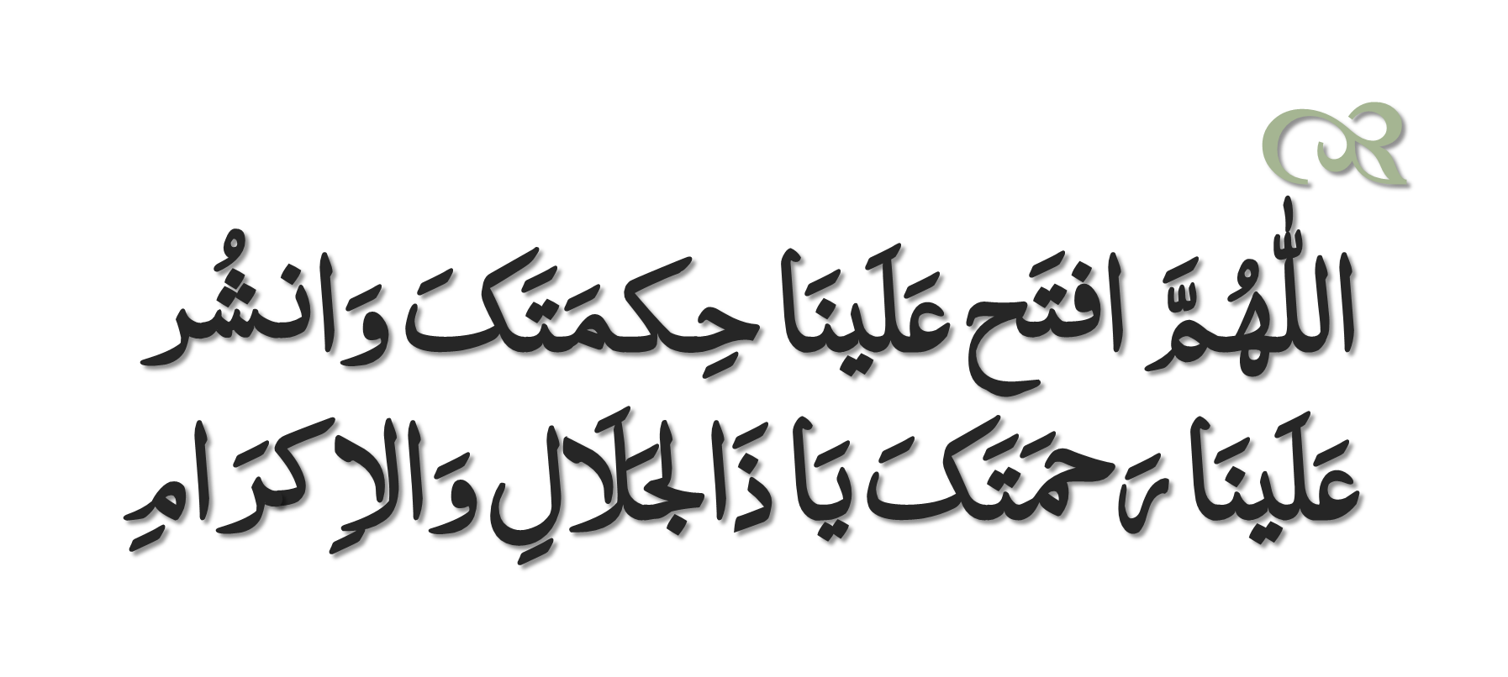
Dua to Recite Before Study

Slide 3
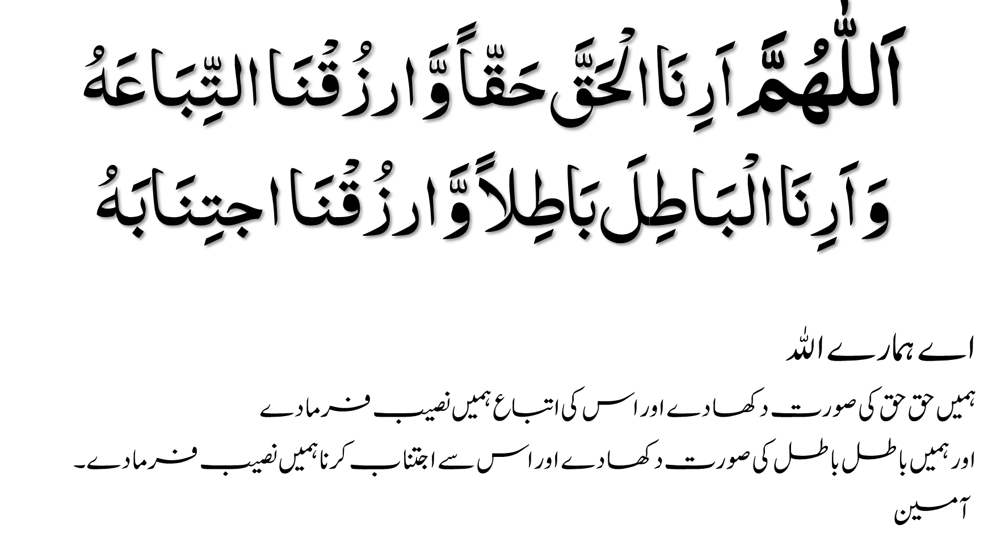

Slide 4

Define the nature and purpose of planning
Classify the types of goals organizations might have and the plans they use
Compare and contrast approaches to goal-setting and planning
Discuss contemporary issues in planning

Slide 5
What Is Planning?
Planning - a primary managerial activity that involves:
Defining the organization’s goals
Establishing an overall strategy for achieving those goals
Developing plans for organizational work activities

Slide 6
Formal Planning
Formal planning
Specific goals covering a specific time period
Written and shared with organizational members

Slide 7
Why Do Managers Plan?
Purposes of Planning
Provides direction
Reduces uncertainty
Minimizes waste and redundancy
Sets the standards for controlling

Slide 8
Planning and Performance
Formal planning is associated with:
Higher profits and returns on assets
Positive financial results
The quality of planning and implementation affects performance more than the extent of planning
The external environment can reduce the impact of planning on performance

Slide 9
Elements of Planning
Goals (also Objectives)
Desired outcomes for individuals, groups, or entire organizations
Provide direction and evaluation performance criteria
Plans
Documents that outline how goals are to be accomplished
Describe how resources are to be allocated and establish activity schedules

Slide 10
Types of Goals
Financial Goals - related to the expected internal financial performance of the organization.
Strategic Goals - related to the performance of the firm relative to factors in its external environment (e.g., competitors).

Slide 11
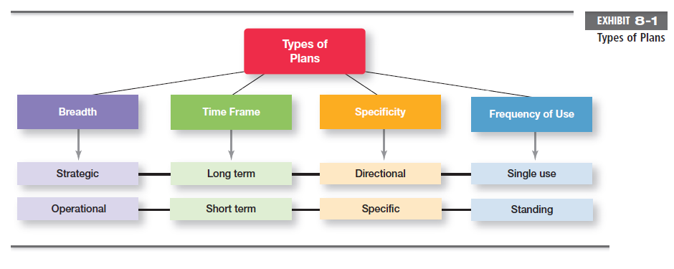

Slide 12
Types of Plans
Strategic Plans
Establish the organization’s overall goals
Seek to position the organization in terms of its environment
Cover extended periods of time
Operational Plans
Specify the details of how the overall goals are to be achieved
Cover a short time period

Slide 13
Types of Plans
Long-Term Plans
Time frames extending beyond three years.
Short-Term Plans
Time frames of one year or less.

Slide 14
Types of Plans
Specific Plans
Plans that are clearly defined and leave no room for interpretation.
Directional Plans
Flexible plans that set out general guidelines and provide focus, yet allow discretion in implementation.

Slide 15
Types of Plans
Single-Use Plan
A one-time plan specifically designed to meet the need of a unique situation.
Standing Plans
Ongoing plans that provide guidance for activities performed repeatedly.

Slide 16
Traditional Goal Setting
Broad goals are set at the top of the organization.
Goals are then broken into sub-goals for each organizational level.
Goals are intended to direct, guide, and constrain from above.
Goals lose clarity and focus as lower-level managers attempt to interpret and define the goals for their areas of responsibility.

Slide 17
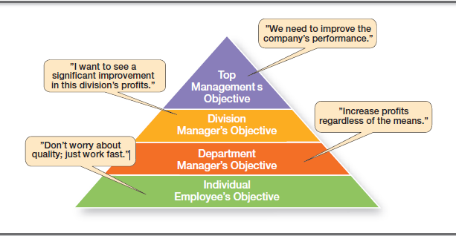
Exhibit 8-2: The Downside of Traditional Goal Setting

Slide 18
Maintaining the Hierarchy of Goals
Means-Ends Chain
The integrated network of goals that results from establishing a clearly-defined hierarchy of organizational goals.
Achievement of lower-level goals is the means by which to reach higher-level goals (ends).

Slide 19
Management By Objectives (MBO)
Specific performance goals are jointly determined by employees and managers.
Progress toward accomplishing goals is periodically reviewed.
Rewards are allocated on the basis of progress towards the goals.

Slide 20
Management By Objectives (MBO)
Key elements of MBO:
goal specificity
participative decision making
an explicit performance/evaluation period
feedback

Slide 21
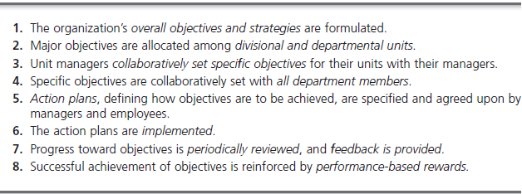
Exhibit 8-3: Steps in a Typical MBO Program

Slide 22
Does MBO Work?
Reason for MBO Success
Top management commitment and involvement
Potential Problems with MBO Programs
Are less effective in dynamic environments that require constant resetting of goals
Overemphasis on individual accomplishment may create problems with teamwork
Allowing the MBO program to become an annual paperwork shuffle

Slide 23
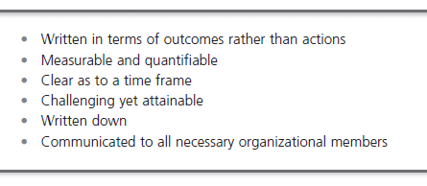
Exhibit 8-4: Well-Written Goals

Slide 24
Steps in Goal Setting
Review the organization’s mission statement.
Do goals reflect the mission?
Evaluate available resources.
Are resources sufficient to accomplish the mission?
Determine goals individually or with others.
Are goals specific, measurable, and timely?

Slide 25
Steps in Goal Setting
Write down the goals and communicate them.
Is everybody on the same page?
Review results and whether goals are being met.
What changes are needed in mission, resources, or goals?

Slide 26
Contingency Factors in Planning
Manager’s level in the organization
Strategic plans at higher levels
Operational plans at lower levels
Degree of environmental uncertainty
Stable environment: specific plans
Dynamic environment: specific but flexible plans

Slide 27
Contingency Factors in Planning
Length of future commitments
Commitment Concept: Current plans affecting future commitments must be sufficiently long-term in order to meet those commitments.

Slide 28
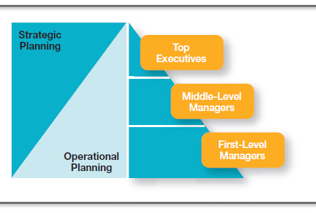
Exhibit 8-5: Planning in the Hierarchy Organizations

Slide 29
Approaches to Planning
Establishing a formal planning department
Create a group of planning specialists that help managers write organizational plans.
Planning is a function of management; it should never become the sole responsibility of planners.

Slide 30
Approaches to Planning
Involving organizational members in the process
Plans are developed by members of organizational units at various levels and then coordinated with other units across the organization.

Slide 31
Criticisms of Planning
Planning may create rigidity.
Plans cannot be developed for dynamic environments.
Formal plans cannot replace intuition and creativity.

Slide 32
Criticisms of Planning
Planning focuses managers’ attention on today’s competition—not tomorrow’s survival.
Formal planning reinforces today’s success, which may lead to tomorrow’s failure.
Planning isn’t enough.

Slide 33
Planning in Dynamic Environments
Develop plans that are specific but flexible.
Understand that planning is an ongoing process.
Change plans when conditions warrant alterations.

Slide 34
Planning in Dynamic Environments
Persistence in planning eventually pays off.
Flatten the organizational hierarchy to foster the development of planning skills at all organizational levels.

Slide 35
Terms to Know
planning
goals
plans
stated goals
real goals
framing
strategic plans
operational plans
long-term plans
short-term plans
specific plans
directional plans
single-use plan
standing plans
traditional goal setting
means-ends chain
management by objectives (MBO)
mission
commitment concept
formal planning department

